Slide 1
Crime Analysis Chicago(2001-present)
1-What is the Percentage of each type of crimes(2001-preset) in Chicago, and which crime has the highest percentage?
2-How does the number of crimes of each type change over years, and which crime has the highest percentage?
3-How does the number arrests compare to the number of crimes ?
4-What is the number of crimes in each Ward in Chicago?
5-What is the number of robberies in each Ward?
6- Which ward has the highest number of robberies, and how does the number of robberies change through out the years in this Ward?
7-What is the concentration of robberies in Chicago in 2017?(View on the map)
Source of Data: catalog.data.gov

Slide 2
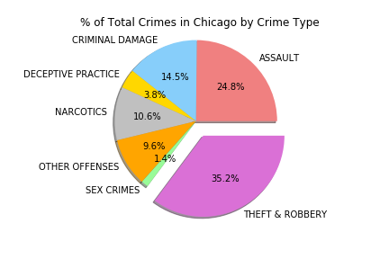
What is the percentage of each type of crimes (2001-preset) in Chicago, and which crime has the highest percentage?

Slide 3
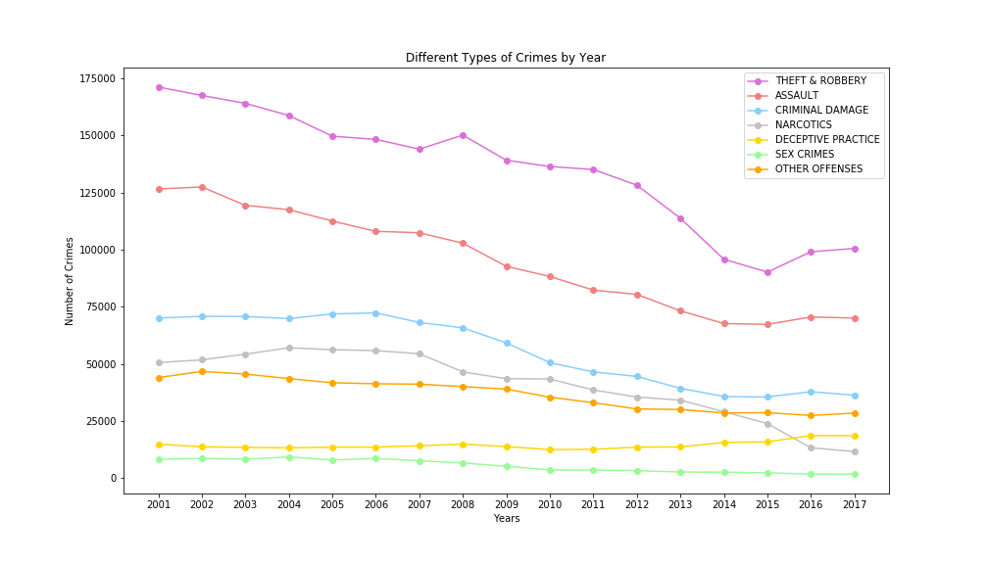
How does the number of crimes of each type change over years, and which crime has the highest percentage?
Notes:
The year 2018 is excluded to have a more accurate plot since the data collection of this year isn’t completed yet

Slide 4
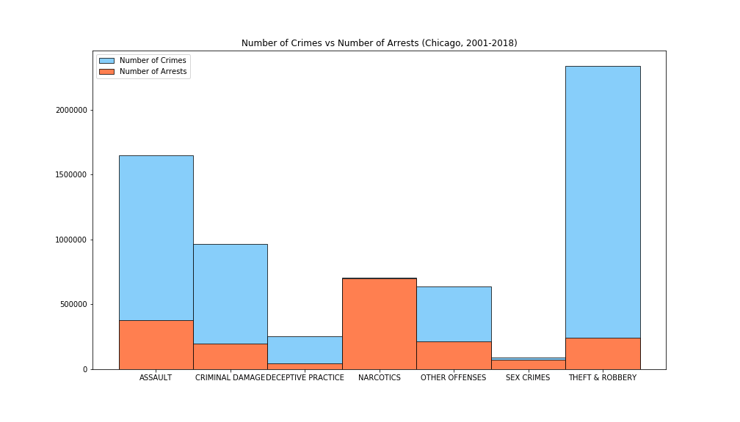
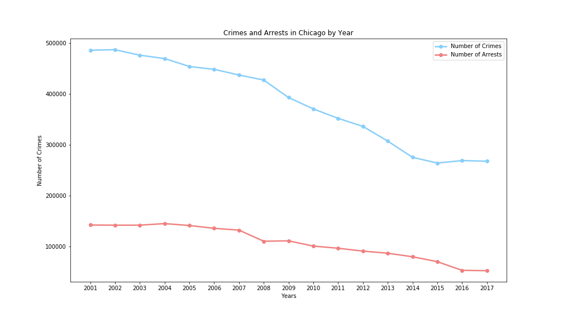
How does the number of arrests compare to the number of crimes ?

Slide 5
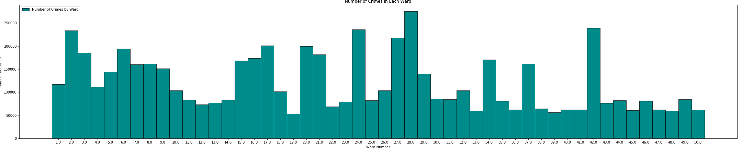
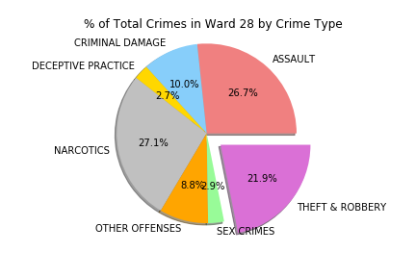
What is the number of crimes in each Ward in Chicago?

Slide 6
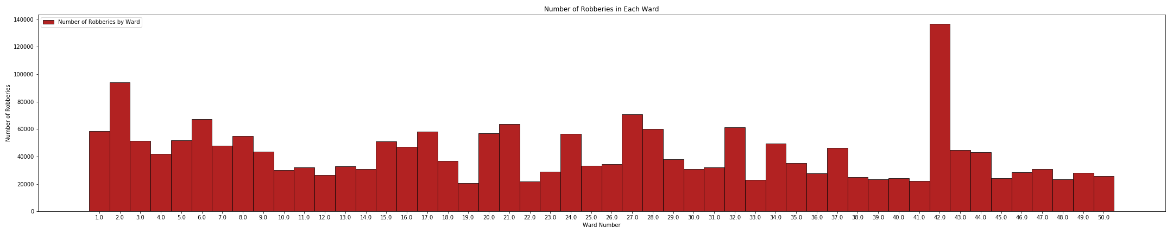
What is the number of robberies in each Ward?

Slide 7
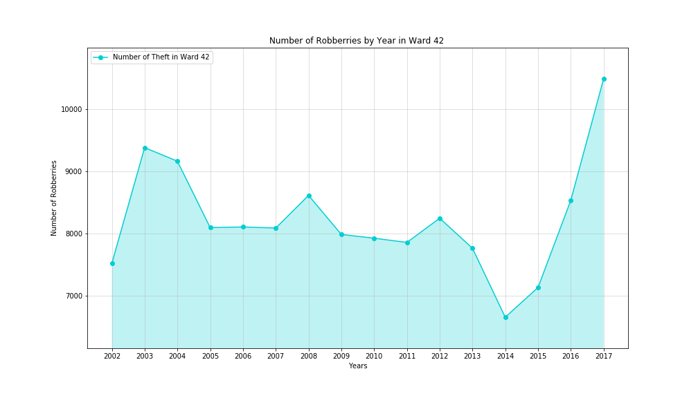
How does the number of robberies change over the years in Ward 42?

Slide 8

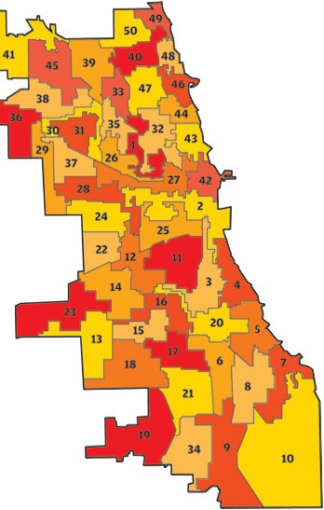
Heat Map presenting the concentration of robberies in 2017

Slide 9
Findings:
All Crimes:
Theft and Robberies:
There is a decrease in the number of crimes of all types from 2001-2017
There is a large discrepancy between the number of crimes and the number of arrests.
Ward 28 has highest number of crimes.
The top crimes in this Ward are narcotics, theft and robberies, and assault, which are almost equal in percentages.
Theft and robberies are the crimes with the highest percentage in Chicago through out the period.
Ward 42 has the highest number of robberies.
There is a dramatic increase of robberies in this Ward in 2017, although there is an overall decrease in the number of robberies in Chicago.

Slide 10




